Slide 1
Predictive Model Based On Supervised ML
Presented To:-
Computer Science Engineering Department
Rajkiya Engineering College
Kannauj
Presented By:-
Abhishek Ray (1783910901)
Dhiraj Gupta (1783910903)
Umeshchandra Yadav (1783910909)

Slide 2
Content
Introduction
Machine Learning
Predictive Model
Experiment And Result
Problem Statement
Objective
Implementation
Result
Conclusion
References

Slide 3
Introduction
In this project we attempt to implement Supervised Machine Learning approach to predict Diamond Prices, Gold Prices, Stock Prices, and Covid-19 India dataset.
We collected dataset from the various Source like Kaggle.com, yahoo finance, etc. and Some library like Scikit-learn for ML algorithms, pandas for analysis, matplotlib & Seaborn for visualization. Then we Analyse data and predict data in the result.
Software and Libraries Used
In this project we use Numpy, Pandas, Seaborn, library for data pre-processing and analysis and Anaconda ,jupyter and Colab use for python coding.

Slide 4
Machine Learning
Machine learning is a sub-field of computer science. In general the field can be simply describe as “given the computer the ability to learn without being explicitly programmed”.
Supervised learning: In this we have sample about something: for each sample we have a set of feature (attribute, variable) and a target variable that we would like to predict. Example.
We have data about | And we would like to predict
E-mails | Spam or Non-Spam
Financial Data (Stock, Gold .etc) | Stock Price Gold Price
News Article | How many views will get

Slide 5
Unsupervised learning: The task in which the training data consist of set of input vector without any corresponding target values.
No labels are given to the learning algorithm, leaving it on its own to find structure in its input. It’s have doing by Clustering, Dimensionality Reduction, Anomaly Detection, others. Example
We have data about | And we would like to predict
Costumers | Find Segments
Credit card transaction | Find consumption patterns
Genomic Data | Find group of genes according to biological function

Slide 6
Reinforcement learning: A form of ML in which the algorithm interacts with a dynamic environment in which it must perform a certain goal. The program is provided feedback in terms of reward and punishments as it navigates the problem space.
Manufacturing Robot
Self-Driving Car
Automatic Trading Software

Slide 7
Predictive modelling is the general concept of building a model that is capable of making predictions
It’s also process of creating testing and validating a model to predict the probability of an outcome. The predictive models have a clear focus on what they want to learn and how they want to learn .
The use of predictive Model in marketing, financial services, insurance, telecommunications, travel, mobility, healthcare, Social Networking and other fields.

Slide 8
In this project we are use Supervised Learning .
Supervised Learning have two model.
Regression
And
Classification

Slide 9
Regression | Classification
Linear Regression | Logistic Regression
KNN Regressor | KNN Classifier
Lasso Regressor | Classification Trees
ANN | ANN

Slide 10
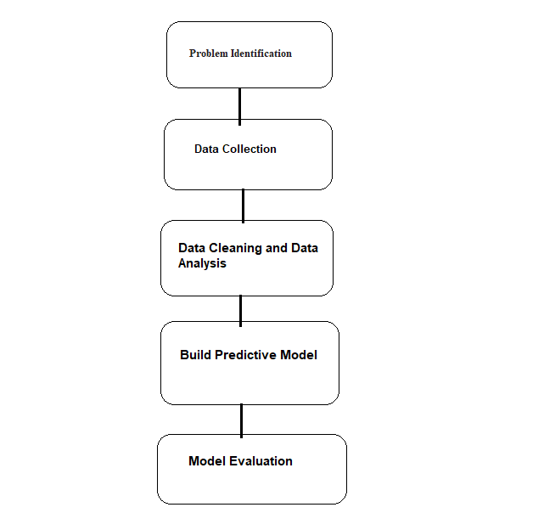
Work-Flow of Predictive Model

Slide 11
Experiment and Result
Diamond Price Prediction
Statement of problem
A company, Intelligent Diamond Reseller (IDR), wants to get into the business of reselling diamonds. They want to innovate in the business, so they will use predictive modelling to estimate how much the market will pay for diamonds. Of course, to sell diamonds in the market, first they have to buy them from the producers; this is where predictive modelling becomes useful.
Objective
In this prediction we use Diamonds data set which containing the prices and other features of almost 54,000 diamonds. When a person or jewelry company want to put a bid to purchase a diamond but is unsure that how much it should bid. In this prediction model to make a recommendation on how much will be bid of a diamond.

Slide 12
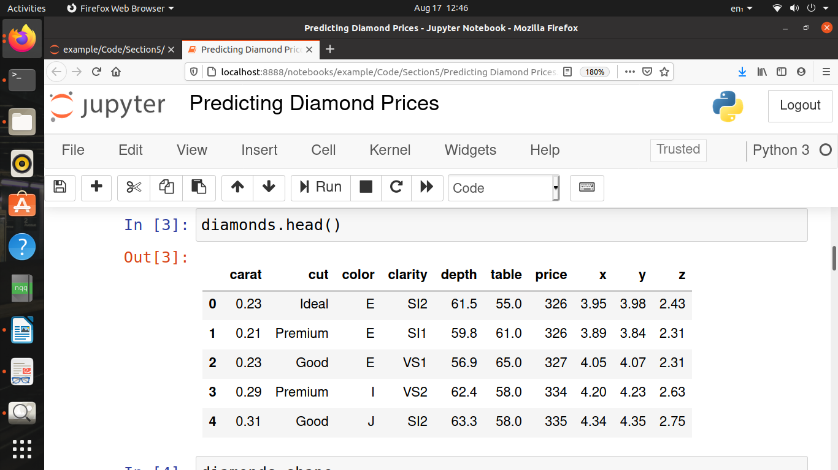
Implementation of Predictive Model
Data Set Information
This project attempts to predict the diamond price with respect to the Cut, Clarity, Color, Price .
We will be using diamond dataset (https://www.kaggle.com/) as the primary source of data. A dataset containing the prices and other features of almost 54,000 diamonds.
Importing useful Libraries & Raw Data
First I am import some useful libraries such as NumPy, Pandas, Matplotlib & then import raw data.
you can see how the original dataset looks like here.

Slide 13
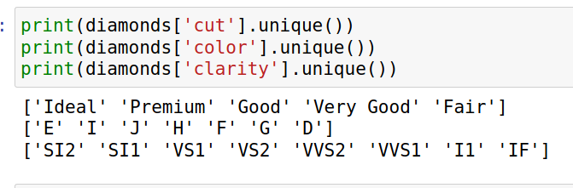
Data Cleaning and Data Analysis
We have 3 categorical variables in this data set.

Slide 14
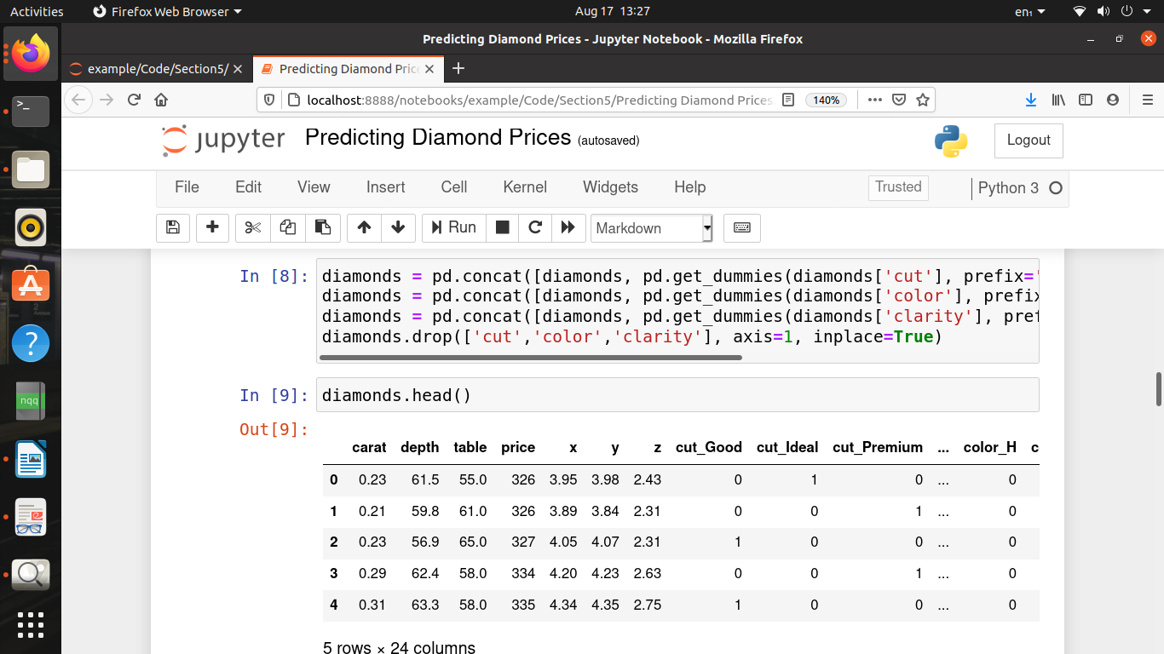
we will do next in this cell is to transform these categorical variables to a set of binary variables or dummy variables. This is the one-hutten coding and we will we have to do this transformation because Scikit-learn accepts only numerical features.

Slide 15
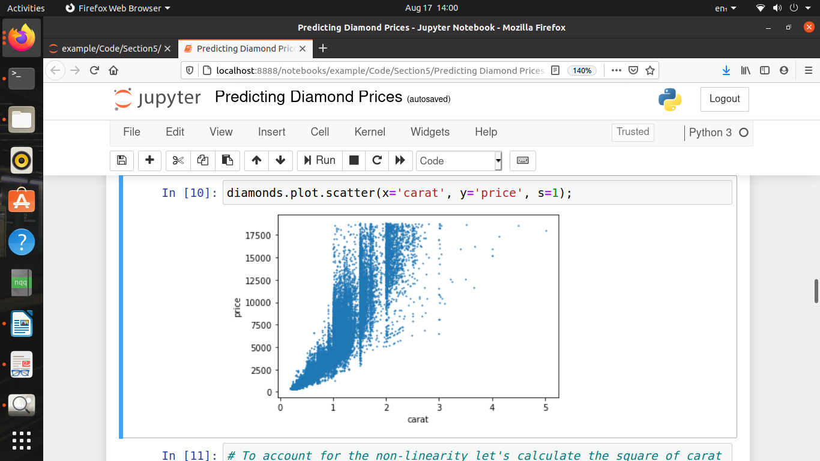
So just I can have to account for the only the oddity of the relationship between carat and price.

Slide 16
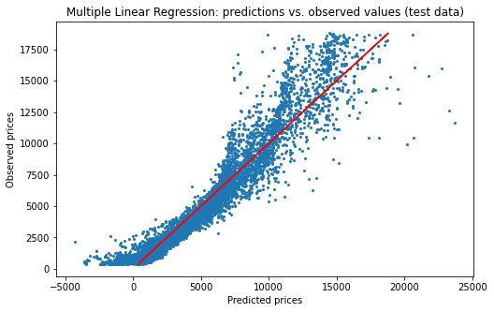
Building Predictive Model using MLR

Slide 17
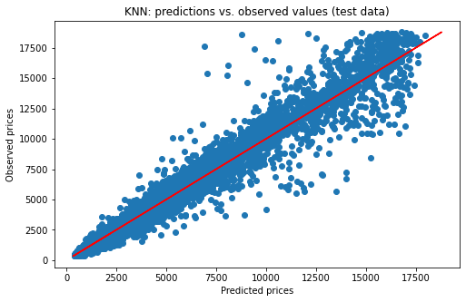
Building Predictive Model using KNN

Slide 18
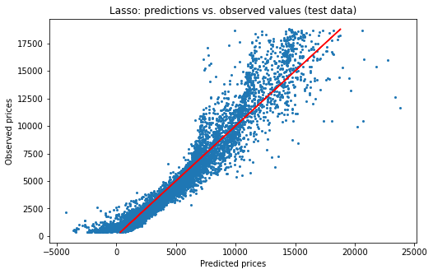
Building Predictive Model using Lasso

Slide 19
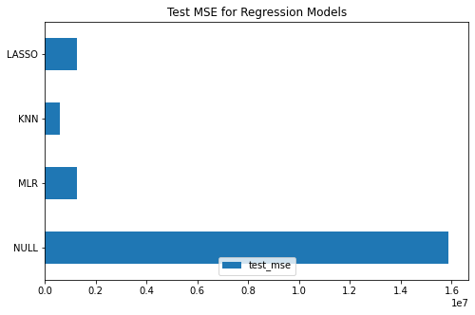
Model Evaluation

Slide 20
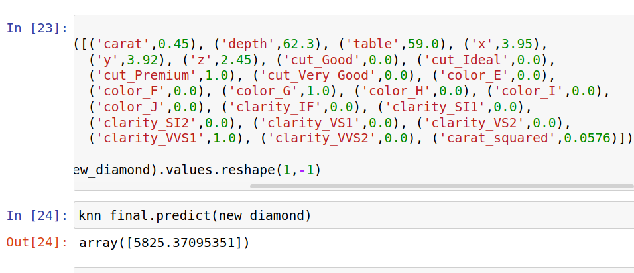
Result:- KNN Prediction model are best suitable for this data and with these Features diamond price predict : $5825 US Dollars

Slide 21
Gold Price Prediction
Statement of problem
Gold is a precious yellow good it use as money. It use as money in the world. The demand of gold is risen. Gold plays an important role as a stabilizing influence for investment portfolios. The gold prices are time series data of gold prices fixed. Factors influencing gold prices are many and we have to be selective in this study to ensure that the model developed is significant.
Objective
In this , we proposed the development for predicting future gold price using Multiple Linear Regression (MLR). The data used in this part are the Gold Prices (GP) from the Yahoo Financial. GP will be the single dependent variable in this model. We began by identifying the factors that influence the price of gold. These factors were used as independent variables in this MLR model. We also use KNN-Regressor for predicting Price of Gold. Here gold price are in US dollar.

Slide 22
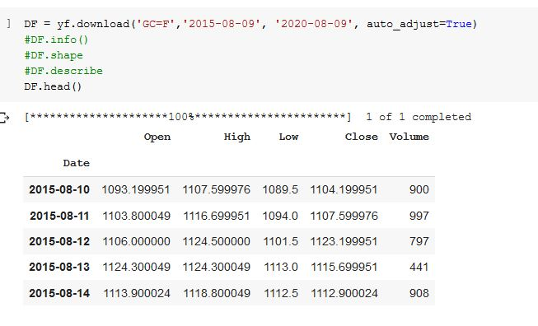
Implementation of Predictive Model
Importing Dataset of Gold We first install library of yahoo financial to fetch data set of gold then importing its library. Dataset have Date, Open, high, close, low and volume. We use dataset between 2015-2020.

Slide 23
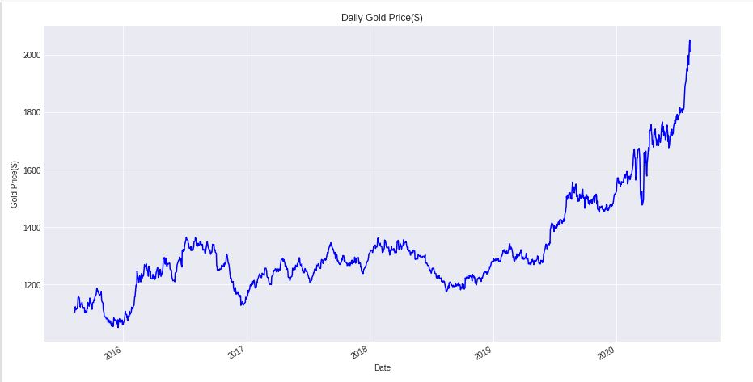
Data Cleaning and Data Analysis
After data collection we do cleaning and Analysis of data set by many different Way. It first fig1 show daily price of gold in graph.

Slide 24
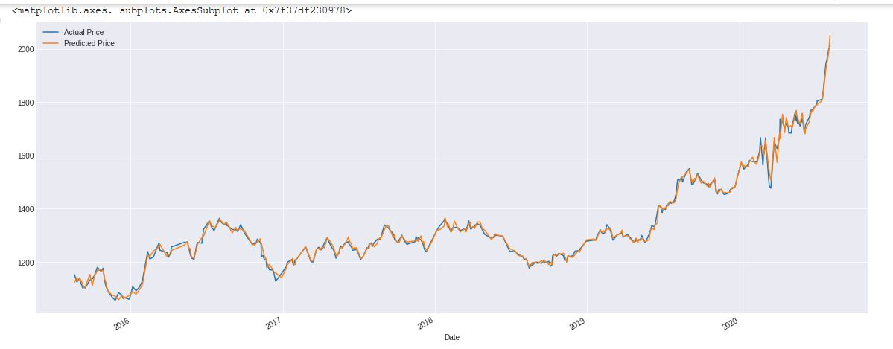
Result of Prediction of Gold Price
Using MLR (Multiple Linear Regressor)

Slide 25
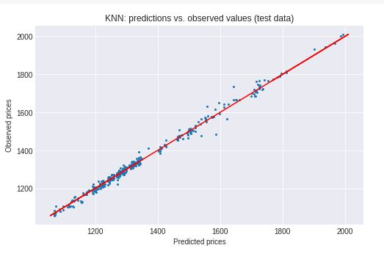
Using KNN-Regressor

Slide 26
Stock Price Prediction
Statements of Problem
Stock market is very vast and difficult to understand. It is considered too uncertain to be predictable due to huge fluctuation of the market.
Financial investors of today are facing this problem of trading as they do not properly understand as to which stocks to buy or which stocks to sell in order to get optimum result. So, the purposed project will reduce the problem with suitable accuracy faced in such real time scenario.
Objective
To identify factors affecting stock market.
To predict an approximate value of share price.
The main feature of this project is to generate an approximate forecasting output and create a general idea of future values based on the previous data by generating a pattern

Slide 27
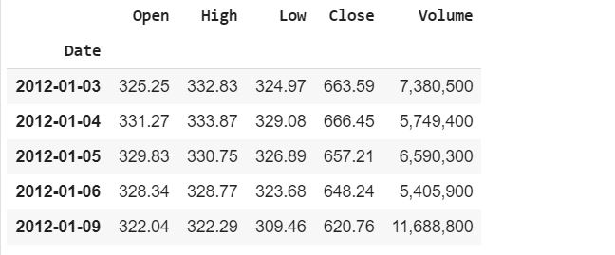
Implementation of Predictive model
Importing Raw Data
This project attempts to predict the stock value with respect to the stock’s previous value and trends. In this we are importing dataset Google Stock price website(https://www.kaggle.com/) as the primary source of data. This website contains all the details such as: Opening value, Closing value, Highest value, Lowest value, volume.

Slide 28
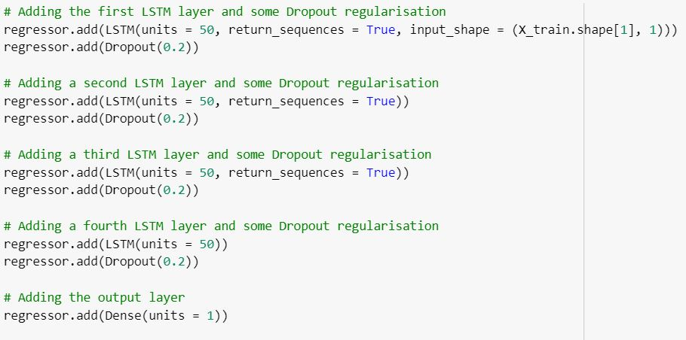
Training neural network
The model here are RNN and LSTM based model for the prediction of stock prices The data is fed to the neural network and trained for prediction assigning random bias and weights.
In this the model composed of sequential Input layer followed by three LSTM layer and a dense layer with activation and finally a dense output layer with linear activation function.

Slide 29
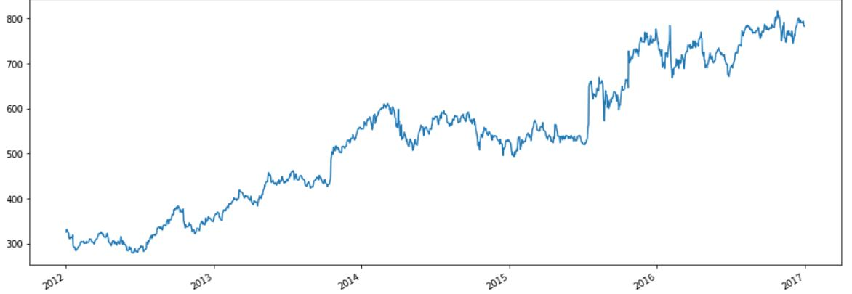
Analysis
The output value generated by the layer of RNN is compared with the target value. The error or the difference between the target and the obtained value is minimized by the back-propagation algorithm.
Growth of Stocks from 2012 to 2017

Slide 30
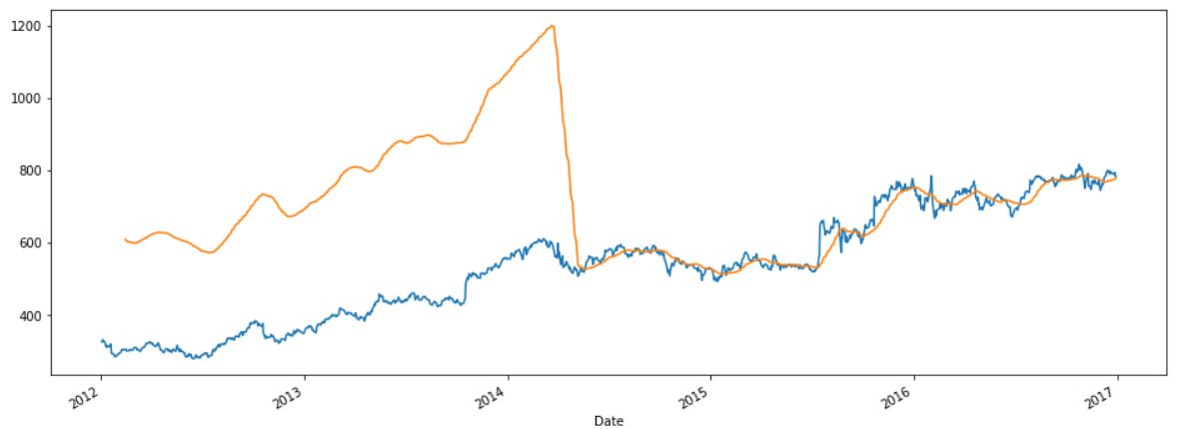
Compares by the Previous Graph to the rolling mean (Moving average of the past 30 days)

Slide 31
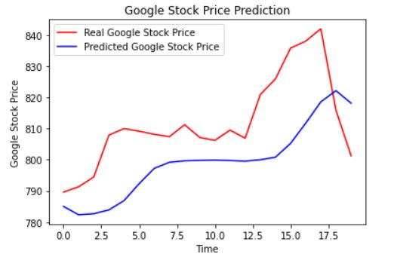
Visualization and Results
A rolling analysis of a time series model is often used to assess the model’s stability over time.
when analyzing financial time series data using a statistical Model, a key assumption is that the parameters of the model are constant over time. Here we are using Iloc to select rows and columns by in order they are appear in the data frame.
To get the Predicted value we are going to merge the train dataset and test dataset on zero axis. And reshape the data.

Slide 32
Covid-19 Cases Prediction
Statement of problem
The outbreak of COVID-19 in different parts of the world is a major concern for all the administrative units of respective countries
In this presents the current situation of coronavirus spread in Uttar Pradesh India. With the help of data sources (till 14th Aug 2020) from Kaggle and Ministry of Health and Family Welfare, Government of India, and presents various trends and patterns.
Objective
In this prediction model we use SVR for predict no of cases how it varies. It can show the map of increasing case and help to Government and people can take many step for controlling rising or cases.

Slide 33
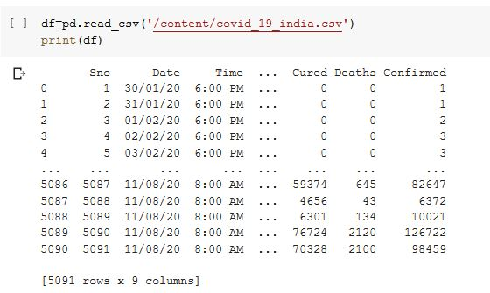
Implementation of Predictive Model
Importing Dataset of Covid-19 India
In this predictive model we use dataset of covid-19 India via Kaggle.com. Dataset contain Date, Number of Confirm case, Number of Cured, and number of Deaths. It also have data details according to state-wise of India. In this dataset have data till 11/08/2020.

Slide 34
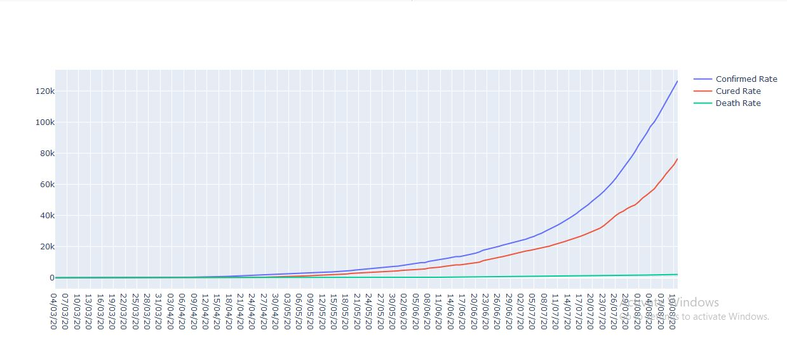
Creating a graph for show Number of cases using plotly library.

Slide 35
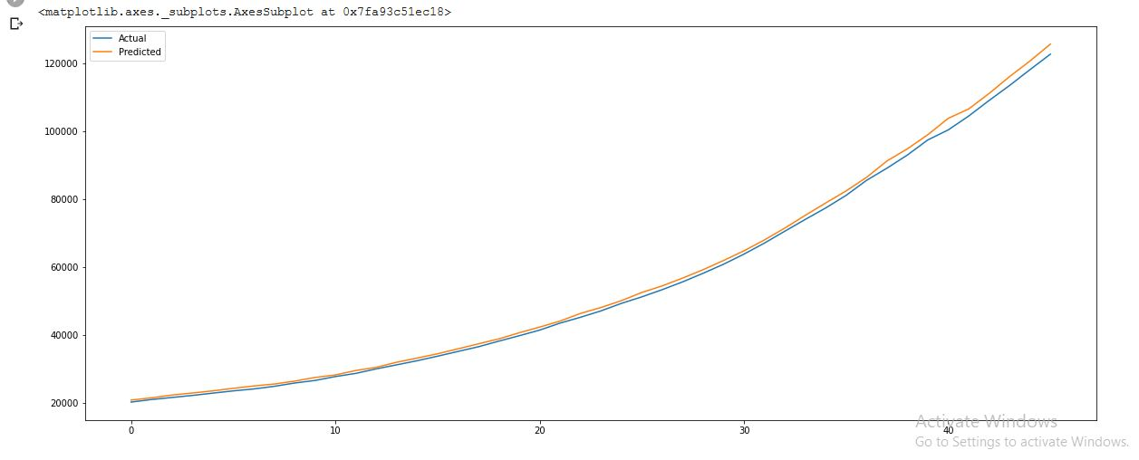
Prediction of Covid-19 prediction using SVR

Slide 36
Conclusion
In this project we build predictive model for diamond price, gold price stock price and covid-19 up case prediction.
In this project study about use predictive model best for these dataset. Very difficult to selecting a predictive model for a dataset because every Dataset have different feature.
In order to development of Diamonds prediction model for a regression model, Here Diamond price in US dollar we do multiple analysis and the build model for predict price using MLR and KNN-Regressor , Lasso.
In order to development of gold prediction model for a regression model, Here gold price in US dollar we do multiple analysis and the build model for predict price using MLR and KNN-Regressor.
In order to development of Covid-19 UP India cases prediction we use a SVR model for predict the number of cases. That show how cases are increasing in state. Then what people can do for stop to spread of covid-19.

Slide 37
References
[1] Z. Sun, F. Chen, M. Chi, and Y. Zhu, “A spark-based big data platform for
massive remote sensing data processing,” in Data Science, New York, NY, USA: Springer, pp. 120–126 2015.
[2] https://en.wikipedia.org/wiki/Predictive_modelling
[3] https://builtin.com/data-science/tour-top-10-algorithms-machine-learning-newbies
[4] https://www.investopedia.com/terms/m/mlr.asp
[5] https://www.digitalistmag.com/digital-economy/2018/03/15/differences-between-machine-learning-predictive-analytics-05977121/
[6] https://www.opensourceforu.com/2018/09/machine-learning-building-a-predictive-model-with-scikit-learn/
[7] https://blogs.gartner.com/jitendra-subramanyam/prediction-models-traditional-versus-machine-learning/
[8] Finlay "Predictive Analytics, Data Mining and Big Data: Myths, Misconceptions and Methods", 1st edition, New York: Palgrave Macmillan, 2014.
[9]. Joubert, D., 2003. The dollar and gold. http://www.sagolds.com
[10] Ismail, Z., F. Jamaluddin and F. Jamaludin, 2008. Time series regression model for forecasting Malaysian electricity load demand. Asian J. Math. Stat., 1: 139-149. DOI: 10.3923/ajms.2008.139.149
[11] Graham, S., 2001. The price of gold and stock price indices for the United States. http://www.gold.org/value/stats/research/

Slide 38
THANKU

